Slide 1
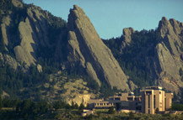
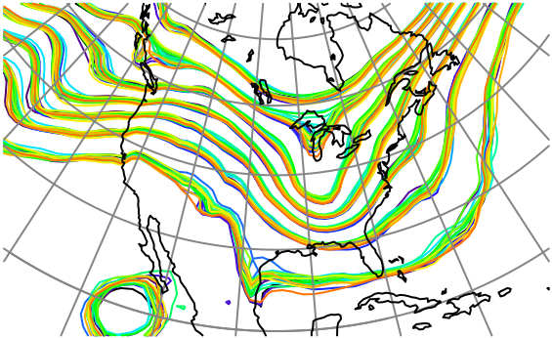

Assimilating Observations with Spatially and Temporally Correlated Errors in a Global Atmospheric Model
Jeffrey Anderson, NCAR Data Assimilation Research Section

Slide 2
Observation Error Time Series
Example: Correlated Error AR1 with Variance 1.
Single Step Cov 0.999. Fixed for all cases.

Slide 3
Observation Error Time Series
Example: Correlated Error AR1 with Variance 1.
Single Step Cov 0.999. Fixed for all cases.
Vary uncorrelated error variance, 0.01

Slide 4
Observation Error Time Series
Example: Correlated Error AR1 with Variance 1.
Single Step Cov 0.999. Fixed for all cases.
Vary uncorrelated error variance, 0.1

Slide 5
Observation Error Time Series
Example: Correlated Error AR1 with Variance 1.
Single Step Cov 0.999. Fixed for all cases.
Vary uncorrelated error variance, 1.0

Slide 6
Observation Error Time Series
Example: Correlated Error AR1 with Variance 1.
Single Step Cov 0.999. Fixed for all cases.
Vary uncorrelated error variance, 10.0

Slide 7
1D Linear Exponential Growth Model
True trajectory is always 0.
Evolution is
Perturbations grow exponentially in time.

Slide 8
Assimilating Correlated Observations
Obs1
Obs2
Obs3
Obs4
Obs5
Obs6

Slide 9
1D Exponential Growth Model Results
Exact Smoother Result. Can’t do better than this.

Slide 10
1D Exponential Growth Model Results
EAKF Poor Unless Uncorrelated Error Dominates
RMSE
Spread

Slide 11
Two Types of Difference Observations
Obs1
Obs2
Obs3
Obs4
Obs5
Obs6

Slide 12
Unlinked Difference Observations
Unlinked
Diff 1
Unlinked
Diff 3
Unlinked
Diff 5
Obs1
Obs2
Obs3
Obs4
Obs5
Obs6

Slide 13
1D Exponential Growth Model Results
Exact Unlinked Difference Obs Much worse.
Exact
Unlinked

Slide 14
Uninked Difference Observations
Unlinked
Diff 1
Unlinked
Diff 3
Unlinked
Diff 5
Obs1
Obs2
Obs3
Obs4
Obs5
Obs6

Slide 15
Uninked Difference Observations
Unlinked
Diff 1
Unlinked
Diff 3
Unlinked
Diff 5
Obs1
Obs2
Obs3
Obs4
Obs5
Obs6

Slide 16
1D Exponential Growth Model Results
EAKF is nearly exact for Unlinked Difference Obs.
RMSE and
Spread

Slide 17
Linked Difference Observations
Linked
Diff 1
Linked
Diff 3
Linked
Diff 5
Obs1
Obs2
Obs3
Obs4
Obs5
Obs6
Linked
Diff 2
Linked
Diff 4

Slide 18
1D Exponential Growth Model Results
Exact linked Difference Obs Nearly Identical to Analytic.
Linked

Slide 19
Linked Difference Observations
Linked
Diff 1
Linked
Diff 3
Linked
Diff 5
Obs1
Obs2
Obs3
Obs4
Obs5
Obs6
Linked
Diff 2
Linked
Diff 4

Slide 20
Linked Difference Observations
Linked
Diff 1
Linked
Diff 3
Linked
Diff 5
Obs1
Obs2
Obs3
Obs4
Obs5
Obs6
Linked
Diff 2
Linked
Diff 4

Slide 21
Linked Difference Observations
Linked
Diff 1
Linked
Diff 3
Linked
Diff 5
Obs1
Obs2
Obs3
Obs4
Obs5
Obs6
Linked
Diff 2
Linked
Diff 4

Slide 22
1D Exponential Growth Model Results
EAKF Linked Diff. Obs. Good when correlated error dominates.
RMSE
Spread

Slide 23
1D Exponential Growth Model Results
Comparison to Just Using Raw Observations
Obs

Slide 24
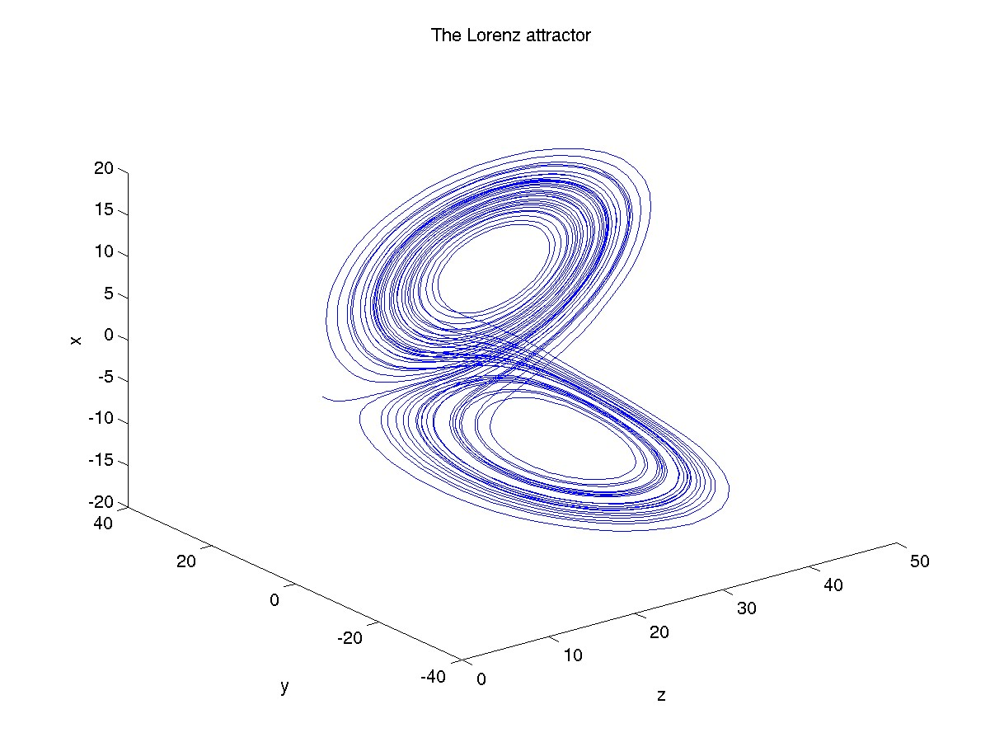
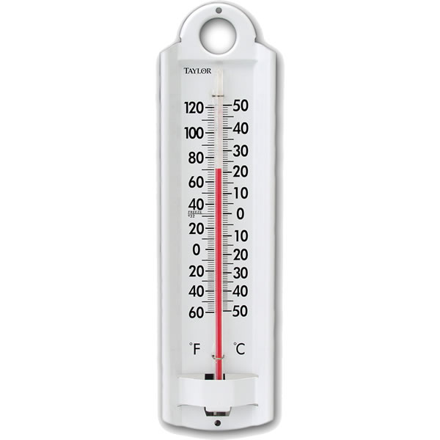
Lorenz 63 Model
Observing System 1
3 Instruments.
Each has own correlated error.

Slide 25
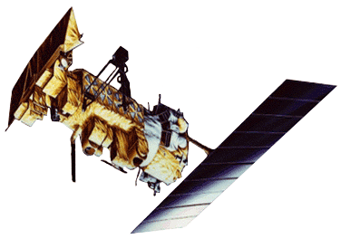
Lorenz 63 Model
Observing System 2
1 Instrument measures x,y,z each time.

Slide 26
L63 Results, Linked Difference Obs
3 Instruments
5 ensemble members.
Adaptive inflation.
Observations every 6 model timesteps.

Slide 27
L63 Results, Linked Difference Obs
3 Instruments
1 Instrument
5 ensemble members.
Adaptive inflation.
Observations every 6 model timesteps.

Slide 28
L63 Summary
Difference obs better unless uncorrelated error variance dominates.
Improvement greater for single instrument.
Ensembles often under-dispersive (what a surprise!).

Slide 29
Lorenz 96 Model, 40-variables
Observing System 1
40 Instruments.
Each has own correlated error.

Slide 30
Lorenz 96 Model, 40-variables
Observing System 2
1 instrument measures all 40 variables each time.

Slide 31
L96 Results, Linked Difference Obs
40 Instruments
10 ensemble members.
Adaptive inflation, 0.2 halfwidth localization.
Observations every model timestep.

Slide 32
L96 Results, Linked Difference Obs
40 Instruments
1 Instrument
10 ensemble members.
Adaptive inflation, 0.2 halfwidth localization.
Observations every model timestep.

Slide 33
L96 Results, Linked Difference Obs
Difference obs better unless uncorrelated error variance dominates.
Improvement much greater for single instrument.
Ensembles often over-dispersive.
Dealing with time correlation harder than space correlation.

Slide 34
Low-Order Dry Dynamical Core
Evolution of surface pressure field every 12 hours.
Has baroclinic instability: storms move east in midlatitudes.
Notes:
Slide 7: GPS occultation forward operators
Non-local refractivity : (Sokolovskiy et al., MWR 133, 2200-2212)
NEED DETAILS OF ALGORITHM step size???
upper limits
grid pictures for different latitudes
Three pictures exist: ~jla/talks_and_meetings/2009/ams/cam_gps_talk/gps_lat*
Expect minor differences with coarse grid, larger near poles

Slide 35
Low-Order Dry Dynamical Core
Evolution of surface pressure field every 12 hours.
Has baroclinic instability: storms move east in midlatitudes.
Notes:
Slide 7: GPS occultation forward operators
Non-local refractivity : (Sokolovskiy et al., MWR 133, 2200-2212)
NEED DETAILS OF ALGORITHM step size???
upper limits
grid pictures for different latitudes
Three pictures exist: ~jla/talks_and_meetings/2009/ams/cam_gps_talk/gps_lat*
Expect minor differences with coarse grid, larger near poles

Slide 36
Low-Order Dry Dynamical Core
Evolution of surface pressure field every 12 hours.
Has baroclinic instability: storms move east in midlatitudes.
Notes:
Slide 7: GPS occultation forward operators
Non-local refractivity : (Sokolovskiy et al., MWR 133, 2200-2212)
NEED DETAILS OF ALGORITHM step size???
upper limits
grid pictures for different latitudes
Three pictures exist: ~jla/talks_and_meetings/2009/ams/cam_gps_talk/gps_lat*
Expect minor differences with coarse grid, larger near poles

Slide 37
Low-Order Dry Dynamical Core
Evolution of surface pressure field every 12 hours.
Has baroclinic instability: storms move east in midlatitudes.
Notes:
Slide 7: GPS occultation forward operators
Non-local refractivity : (Sokolovskiy et al., MWR 133, 2200-2212)
NEED DETAILS OF ALGORITHM step size???
upper limits
grid pictures for different latitudes
Three pictures exist: ~jla/talks_and_meetings/2009/ams/cam_gps_talk/gps_lat*
Expect minor differences with coarse grid, larger near poles

Slide 38
Low-Order Dry Dynamical Core
Evolution of surface pressure field every 12 hours.
Has baroclinic instability: storms move east in midlatitudes.
Notes:
Slide 7: GPS occultation forward operators
Non-local refractivity : (Sokolovskiy et al., MWR 133, 2200-2212)
NEED DETAILS OF ALGORITHM step size???
upper limits
grid pictures for different latitudes
Three pictures exist: ~jla/talks_and_meetings/2009/ams/cam_gps_talk/gps_lat*
Expect minor differences with coarse grid, larger near poles

Slide 39
Low-Order Dry Dynamical Core
Evolution of surface pressure field every 12 hours.
Has baroclinic instability: storms move east in midlatitudes.
Notes:
Slide 7: GPS occultation forward operators
Non-local refractivity : (Sokolovskiy et al., MWR 133, 2200-2212)
NEED DETAILS OF ALGORITHM step size???
upper limits
grid pictures for different latitudes
Three pictures exist: ~jla/talks_and_meetings/2009/ams/cam_gps_talk/gps_lat*
Expect minor differences with coarse grid, larger near poles

Slide 40
Low-Order Dry Dynamical Core
Evolution of surface pressure field every 12 hours.
Has baroclinic instability: storms move east in midlatitudes.
Notes:
Slide 7: GPS occultation forward operators
Non-local refractivity : (Sokolovskiy et al., MWR 133, 2200-2212)
NEED DETAILS OF ALGORITHM step size???
upper limits
grid pictures for different latitudes
Three pictures exist: ~jla/talks_and_meetings/2009/ams/cam_gps_talk/gps_lat*
Expect minor differences with coarse grid, larger near poles

Slide 41
Low-Order Dry Dynamical Core
Evolution of surface pressure field every 12 hours.
Has baroclinic instability: storms move east in midlatitudes.
Notes:
Slide 7: GPS occultation forward operators
Non-local refractivity : (Sokolovskiy et al., MWR 133, 2200-2212)
NEED DETAILS OF ALGORITHM step size???
upper limits
grid pictures for different latitudes
Three pictures exist: ~jla/talks_and_meetings/2009/ams/cam_gps_talk/gps_lat*
Expect minor differences with coarse grid, larger near poles

Slide 42
Low-Order Dry Dynamical Core
Evolution of surface pressure field every 12 hours.
Has baroclinic instability: storms move east in midlatitudes.
Notes:
Slide 7: GPS occultation forward operators
Non-local refractivity : (Sokolovskiy et al., MWR 133, 2200-2212)
NEED DETAILS OF ALGORITHM step size???
upper limits
grid pictures for different latitudes
Three pictures exist: ~jla/talks_and_meetings/2009/ams/cam_gps_talk/gps_lat*
Expect minor differences with coarse grid, larger near poles

Slide 43
Low-Order Dry Dynamical Core
Evolution of surface pressure field every 12 hours.
Has baroclinic instability: storms move east in midlatitudes.
Notes:
Slide 7: GPS occultation forward operators
Non-local refractivity : (Sokolovskiy et al., MWR 133, 2200-2212)
NEED DETAILS OF ALGORITHM step size???
upper limits
grid pictures for different latitudes
Three pictures exist: ~jla/talks_and_meetings/2009/ams/cam_gps_talk/gps_lat*
Expect minor differences with coarse grid, larger near poles

Slide 44
Low-Order Dry Dynamical Core: Grid
30x60 horizontal grid, 5 levels.
Surface pressure, temperature, wind components.
28,800 variables.
Notes:
Slide 7: GPS occultation forward operators
Non-local refractivity : (Sokolovskiy et al., MWR 133, 2200-2212)
NEED DETAILS OF ALGORITHM step size???
upper limits
grid pictures for different latitudes
Three pictures exist: ~jla/talks_and_meetings/2009/ams/cam_gps_talk/gps_lat*
Expect minor differences with coarse grid, larger near poles

Slide 45
Low-Order Dry Dynamical Core: Observations
Assimilate once per day. 0.2 radian localization.
Observe each surface pressure grid point.
Uncorrelated obs error variance 100 Pa.
Notes:
Slide 7: GPS occultation forward operators
Non-local refractivity : (Sokolovskiy et al., MWR 133, 2200-2212)
NEED DETAILS OF ALGORITHM step size???
upper limits
grid pictures for different latitudes
Three pictures exist: ~jla/talks_and_meetings/2009/ams/cam_gps_talk/gps_lat*
Expect minor differences with coarse grid, larger near poles

Slide 46
Low-Order Dry Dynamical Core: Observations
Uncorrelated obs error variance 100 Pa.
Correlated obs error along ‘simulated polar orbiter track’.
Vary ratio of correlated to uncorrelated obs error variance.
Notes:
Slide 7: GPS occultation forward operators
Non-local refractivity : (Sokolovskiy et al., MWR 133, 2200-2212)
NEED DETAILS OF ALGORITHM step size???
upper limits
grid pictures for different latitudes
Three pictures exist: ~jla/talks_and_meetings/2009/ams/cam_gps_talk/gps_lat*
Expect minor differences with coarse grid, larger near poles

Slide 47
Low-Order Dry Dynamical Core: PS Results
Linked difference better for large correlated error.
Standard better for small correlated error.
Notes:
Slide 7: GPS occultation forward operators
Non-local refractivity : (Sokolovskiy et al., MWR 133, 2200-2212)
NEED DETAILS OF ALGORITHM step size???
upper limits
grid pictures for different latitudes
Three pictures exist: ~jla/talks_and_meetings/2009/ams/cam_gps_talk/gps_lat*
Expect minor differences with coarse grid, larger near poles

Slide 48
Low-Order Dry Dynamical Core: T Results
Linked difference better for large correlated error.
Standard better for small correlated error.
Notes:
Slide 7: GPS occultation forward operators
Non-local refractivity : (Sokolovskiy et al., MWR 133, 2200-2212)
NEED DETAILS OF ALGORITHM step size???
upper limits
grid pictures for different latitudes
Three pictures exist: ~jla/talks_and_meetings/2009/ams/cam_gps_talk/gps_lat*
Expect minor differences with coarse grid, larger near poles

Slide 49
PS RMSE Structure: Large Uncorrelated Error, Ratio 4
Base errors largest in storm tracks.
Linked difference errors largest in broad tropical band.
Notes:
Slide 7: GPS occultation forward operators
Non-local refractivity : (Sokolovskiy et al., MWR 133, 2200-2212)
NEED DETAILS OF ALGORITHM step size???
upper limits
grid pictures for different latitudes
Three pictures exist: ~jla/talks_and_meetings/2009/ams/cam_gps_talk/gps_lat*
Expect minor differences with coarse grid, larger near poles

Slide 50
PS RMSE Structure: Moderate Uncorrelated Error, Ratio 1
Base errors largest in storm tracks.
Linked difference errors largest in broad tropical band.
Notes:
Slide 7: GPS occultation forward operators
Non-local refractivity : (Sokolovskiy et al., MWR 133, 2200-2212)
NEED DETAILS OF ALGORITHM step size???
upper limits
grid pictures for different latitudes
Three pictures exist: ~jla/talks_and_meetings/2009/ams/cam_gps_talk/gps_lat*
Expect minor differences with coarse grid, larger near poles

Slide 51
PS RMSE Structure: Small Uncorrelated Error, Ratio 1/4
Base errors largest in storm tracks.
Linked difference errors largest in broad tropical band.
Notes:
Slide 7: GPS occultation forward operators
Non-local refractivity : (Sokolovskiy et al., MWR 133, 2200-2212)
NEED DETAILS OF ALGORITHM step size???
upper limits
grid pictures for different latitudes
Three pictures exist: ~jla/talks_and_meetings/2009/ams/cam_gps_talk/gps_lat*
Expect minor differences with coarse grid, larger near poles

Slide 52
T RMSE Structure: Small Uncorrelated Error, Ratio 1/4
Base errors largest in tropics.
Linked difference errors have similar pattern.
Notes:
Slide 7: GPS occultation forward operators
Non-local refractivity : (Sokolovskiy et al., MWR 133, 2200-2212)
NEED DETAILS OF ALGORITHM step size???
upper limits
grid pictures for different latitudes
Three pictures exist: ~jla/talks_and_meetings/2009/ams/cam_gps_talk/gps_lat*
Expect minor differences with coarse grid, larger near poles

Slide 53
Low-Order Dry Dynamical Core Summary
Linked difference obs better for large correlated error.
Linked difference not sensitive to correlated error size.
Adaptive inflation struggles with large correlated error.
Could use base approach for uncorrelated obs,
difference for correlated error obs.
For example, base for sondes, difference for radiances.
Difference obs allows assimilating before knowing correlated error characteristics.
Notes:
Slide 7: GPS occultation forward operators
Non-local refractivity : (Sokolovskiy et al., MWR 133, 2200-2212)
NEED DETAILS OF ALGORITHM step size???
upper limits
grid pictures for different latitudes
Three pictures exist: ~jla/talks_and_meetings/2009/ams/cam_gps_talk/gps_lat*
Expect minor differences with coarse grid, larger near poles

Slide 54
Learn more about DART at:
www.image.ucar.edu/DAReS/DART
Anderson, J., Hoar, T., Raeder, K., Liu, H., Collins, N., Torn, R., Arellano, A., 2009: The Data Assimilation Research Testbed: A community facility.
BAMS, 90, 1283—1296, doi: 10.1175/2009BAMS2618.1

